Slide 1
Chapter 12

Slide 2
Objectives

Slide 3
Objectives (continued)

Slide 4
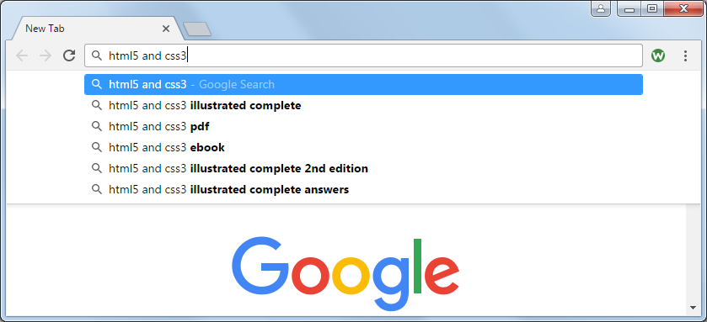
Google’s Auto Suggest is an Ajax application

Slide 5
How a normal HTTP request is processed

Slide 6
How an Ajax XMLHttpRequest is processed

Slide 7
The common data formats for Ajax

Slide 8
XML data

Slide 9
JSON data

Slide 10
Terms

Slide 11
Members of the XMLHttpRequest object

Slide 12
A web page that uses the XHR object and JavaScript to load XML data

Slide 13
The XML file (team.xml)

Slide 14
The JavaScript for getting and parsing the data

Slide 15
The methods for working with Ajax

Slide 16
Examples of Ajax methods

Slide 17
A web page that loads HTML elements when one of the links is clicked

Slide 18
The start of the second section element in the solutions.html file

Slide 19
The jQuery that loads the data when a link is clicked

Slide 20
A web page that loads XML data

Slide 21
The XML file (team.xml)

Slide 22
The jQuery

Slide 23
A web page that loads JSON data

Slide 24
The JSON file (team.json)

Slide 25
The jQuery

Slide 26
Two ways to send data with an Ajax request

Slide 27
The helper methods for working with Ajax

Slide 28
The syntax of the $.ajax method

Slide 29
Terms

Slide 30
A web page with a loading message and an alert dialog box for an error

Slide 31
The XML file

Slide 32
The jQuery for the $.ajax method

Slide 33
The URL for the Flickr public feed documentation

Slide 34
The base URL for retrieving a public photo stream

Slide 35
Examples of URLs for JSON feeds (in one line)

Slide 36
Data items returned by a photo feed

Slide 37
jQuery code that gets Flickr titles and photos

Slide 38
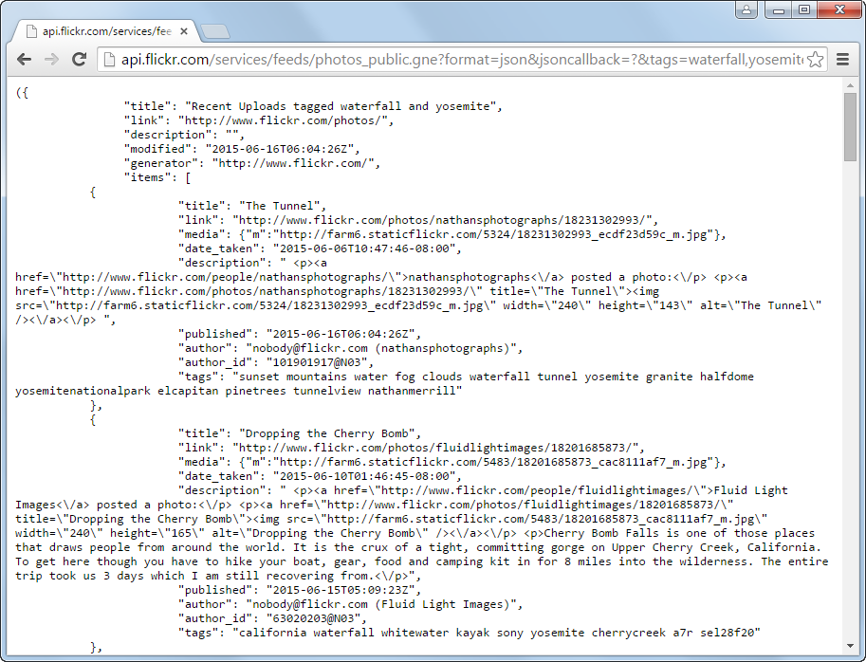
The Flickr feed for the URL

Slide 39
A page that displays Flickr titles and descriptions

Slide 40
The description for the first item in the JSON feed

Slide 41
The jQuery that retrieves and displays the data

Slide 42
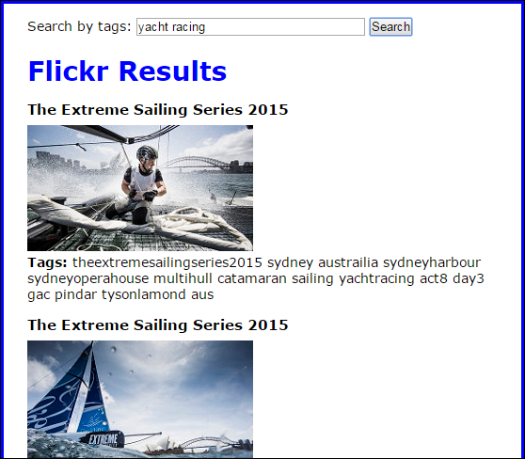
A web page that searches for photos by tags

Slide 43
The HTML that gets the tags and receives the Flickr data

Slide 44
The jQuery

Slide 45
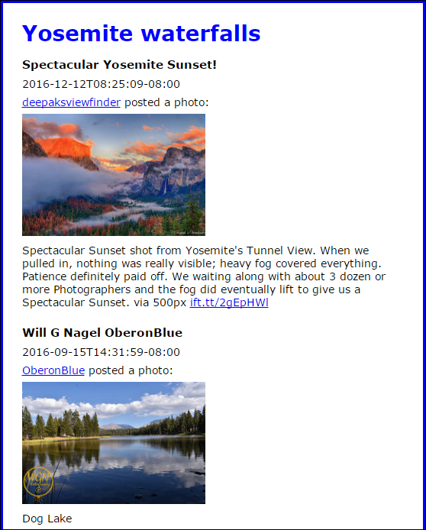
Exercise 12-1 Add information to a Flickr app

Slide 46
Extra 12-1 Convert an Ajax app from XML to JSON

Slide 47
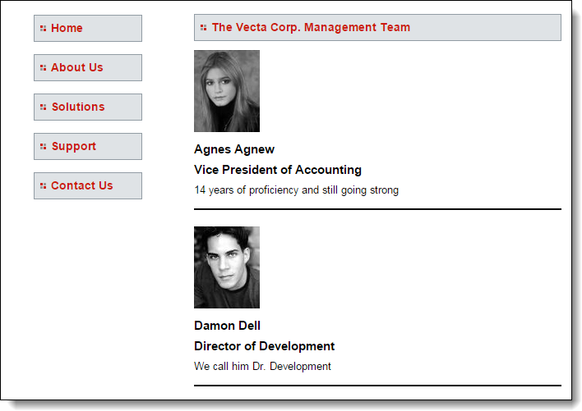
Extra 12-2 Enhance an Ajax application so it uses an expanded JSON file

Slide 48
Extra 12-3 Load speakers as they’re requested

Slide 49
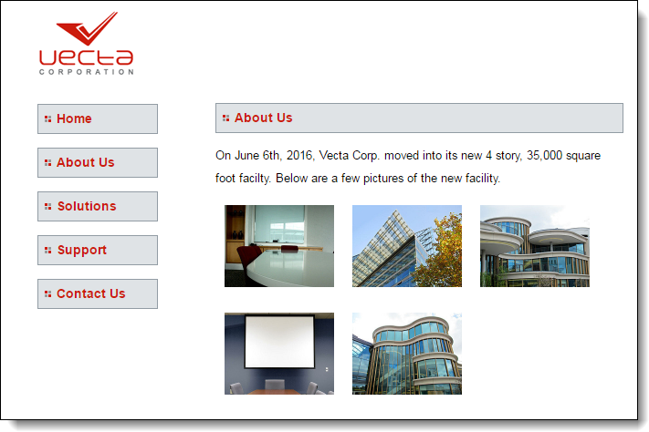
Extra 12-4 Display a gallery of Flickr photos

Slide 50
Short 12-1 Convert a $.getJSON() method to $.ajax()

